Slide 1
Food Project
Exploratory Data Analysis
Shengtao Tony Hou
Sep 26th, 2022

Slide 2
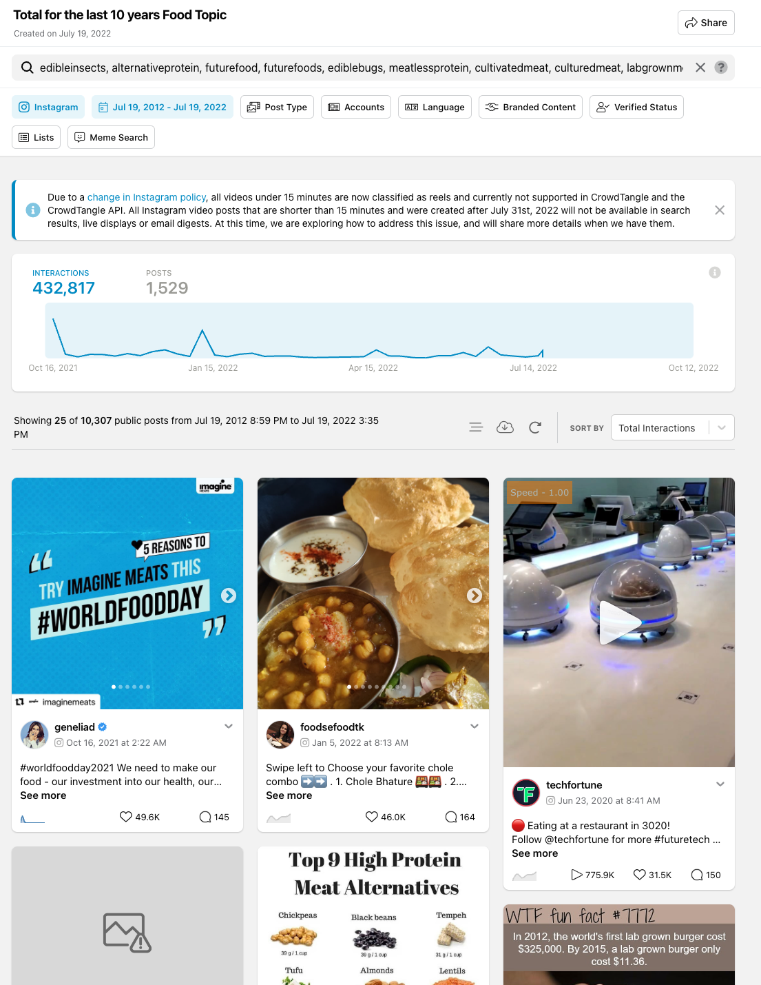
Data Collections
The following is the query used to search for the posts from Instagram and Facebook platform with each keyword connected by “,” to search for posts that contains any of them:
edibleinsects, alternativeprotein, futurefood, futurefoods, ediblebugs, meatlessprotein, cultivatedmeat, culturedmeat, labgrownmeat, foodunfolded, cleanmeat
Time constraint is set to search for posts created from 2012-08-17 till 2022-07-19

Slide 3
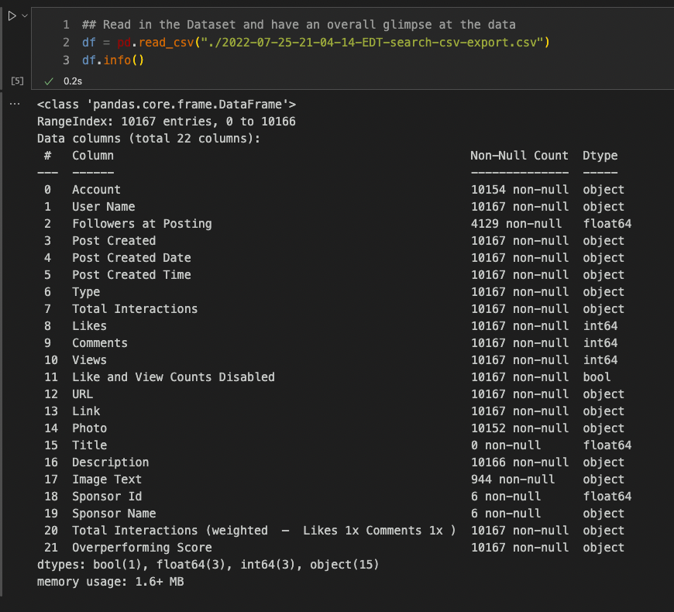
Instagram Dataset Overview
Dataframe Info:
We extracted the data from Instagram using Crowdtangle API and the overall dataset has about 10167 data entries, which means there are 10167 records of posts.
A total of 2237 unique user is identified in the dataset as well

Slide 4
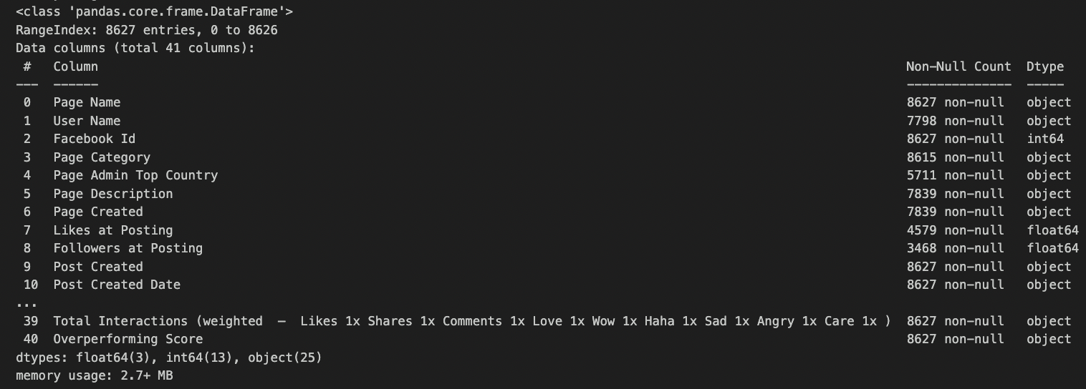
Facebook Dataset Overview
We extracted the data from Facebook using Crowdtangle API and the overall dataset has about 8627 data entries, which means there are 8627 records of posts.
A total of 7798 unique user is identified in the dataset as well
Dataset includes post created from 2012-08-17 till 2022-07-19

Slide 5
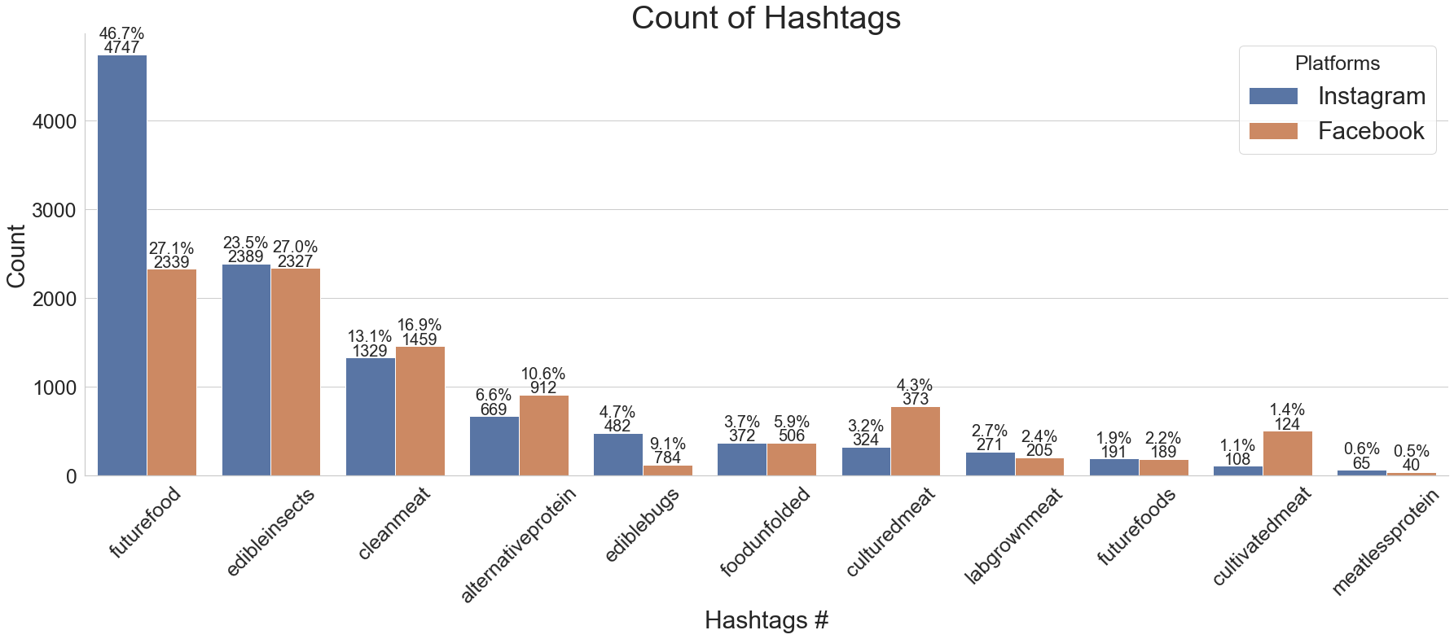
Data Visualization
Plotting the 10 specific Hashtag that was originally requested for our project, showing the count of each Hashtag and its percentage distribution for each Platform (Instagram & Facebook)

Slide 6
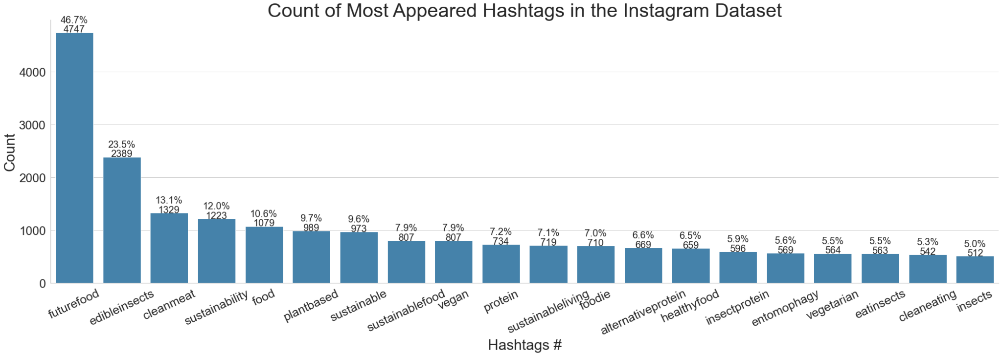
Data Visualization
Plotting the top 20 highest occurrence hashtags, showing the count of each Hashtag and its percentage distribution

Slide 7
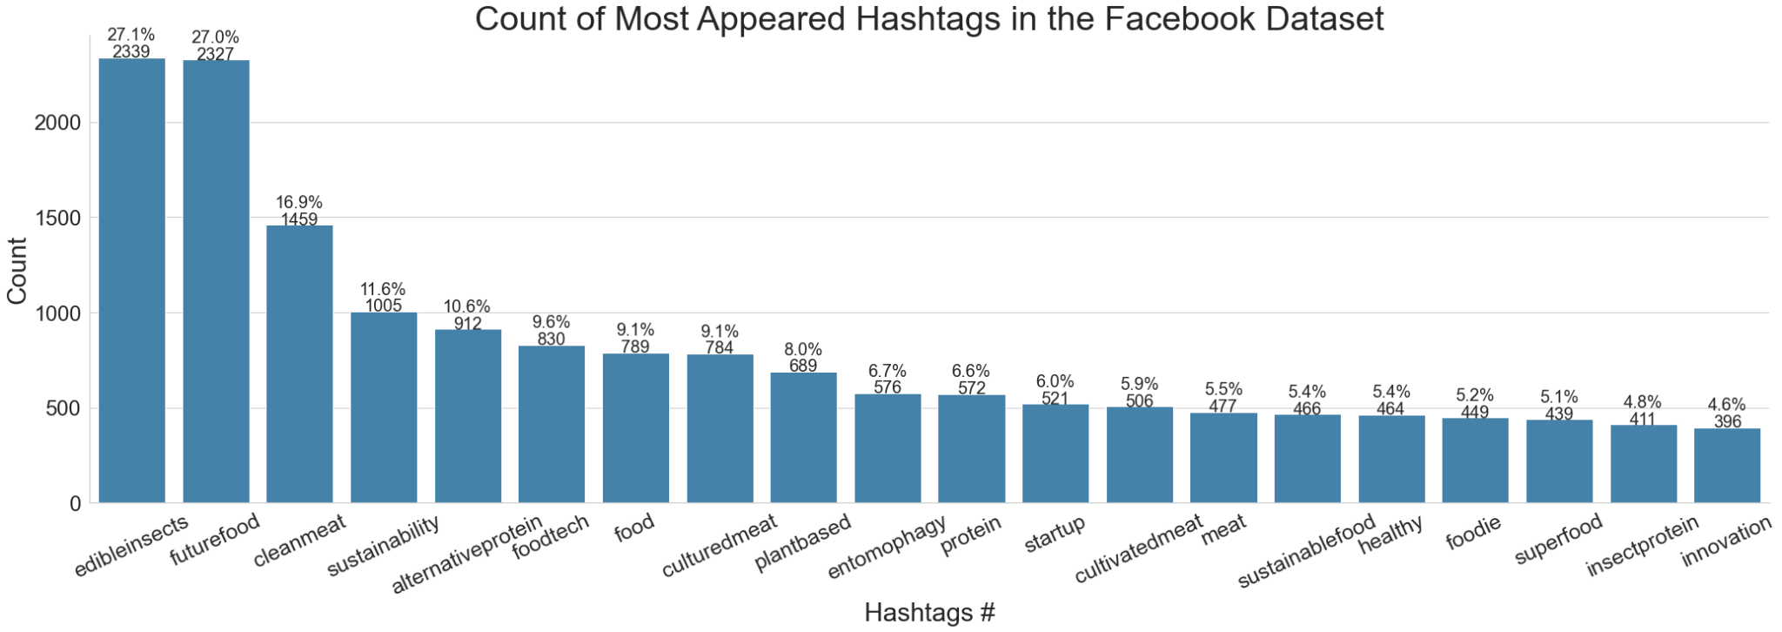
Data Visualization
Plotting the top 20 highest occurrence hashtags, showing the count of each Hashtag and its percentage distribution for the Facebook Dataset

Slide 8
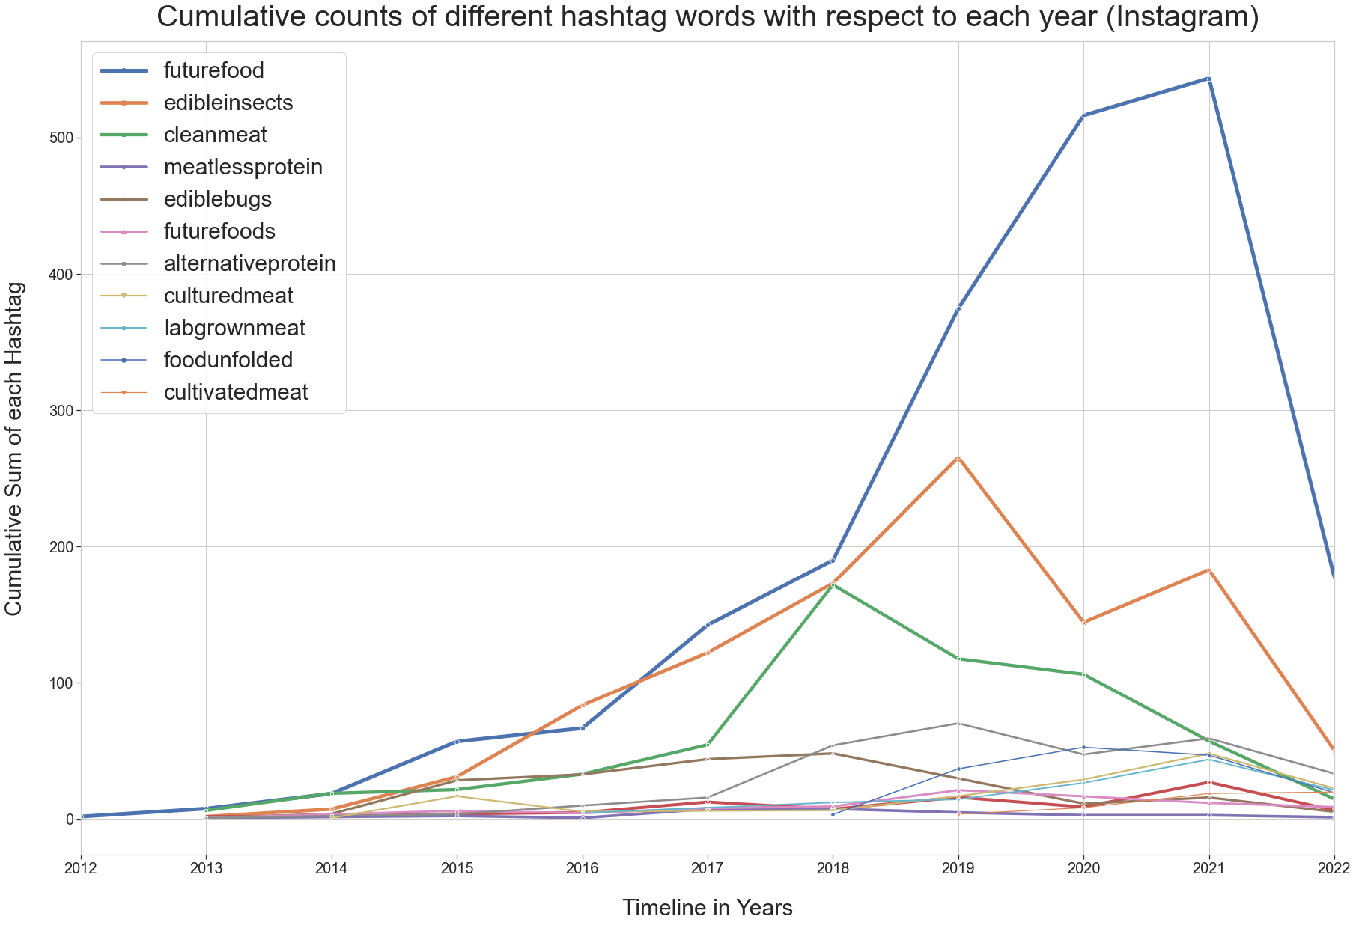
Data Visualization
X is our time axis and y is the Cumulative sum of the occurrence of Hashtags
#Futurefood had the most cumulative occurrence in 2021 and it also experienced a drastic decrease in occurrence in the year following
The same trend happened for #Edibleinsects but it experienced its most occurrence earlier than #Futurefood in the year of 2019

Slide 9
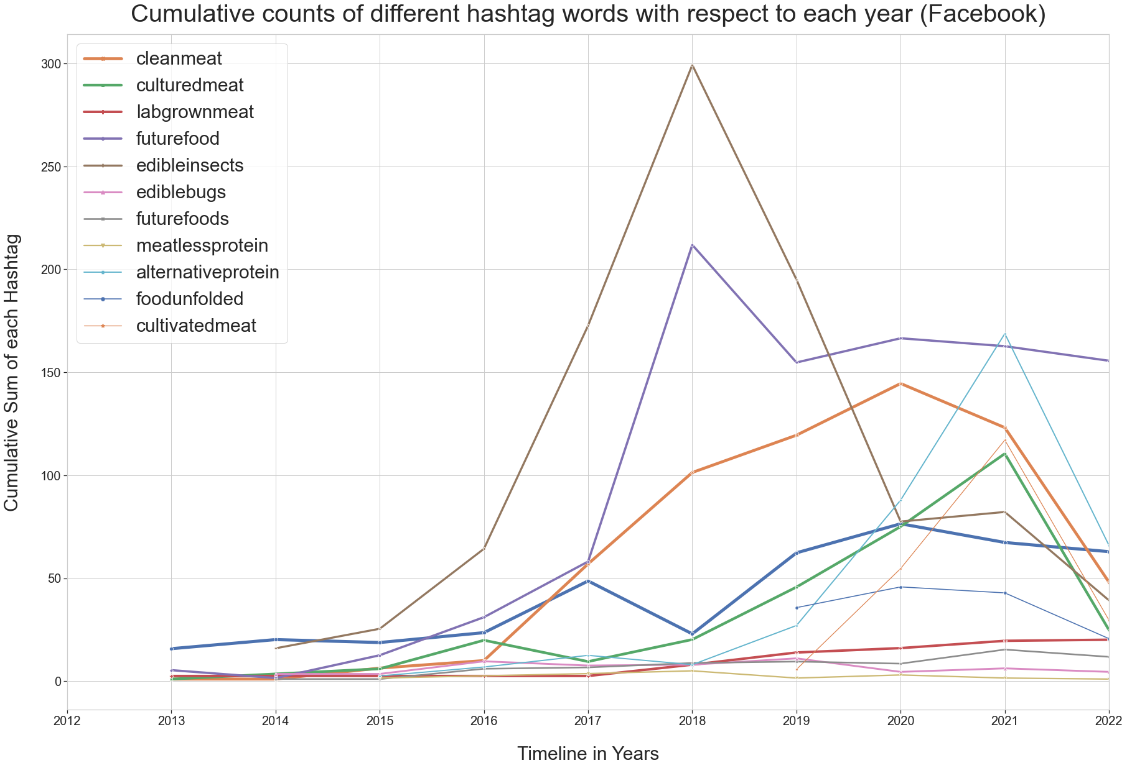
Data Visualization
X is our time axis and y is the Cumulative sum of the occurrence of Hashtags
#edibleinsects had experienced the most cumulative occurrence during the year 2018 and had a huge drop in popularity in the following years
#Futurefood had a similar trend, the hashtag had its highest occurrence in a single year in 2018 and plateaued in the years following

Slide 10
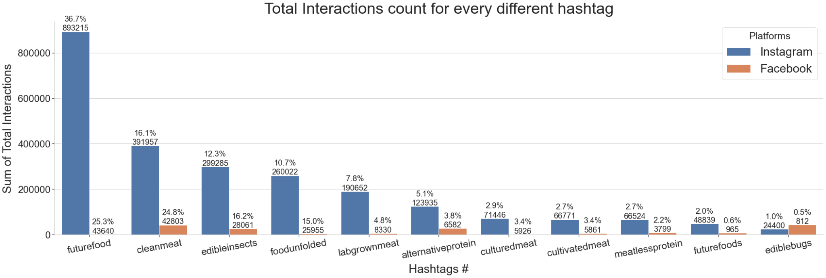
Data Visualization
According to Crowdtangle Glossary, Total Intereactions represent the total number of likes and comments on an Instagram Post, and The total number of reactions, shares and comments on a Facebook post.
We could isolate a single hashtag and see its true effect on Total Interactions since a single post often mentions multiple Hashtags, we’ll modify this later in our project

Slide 11
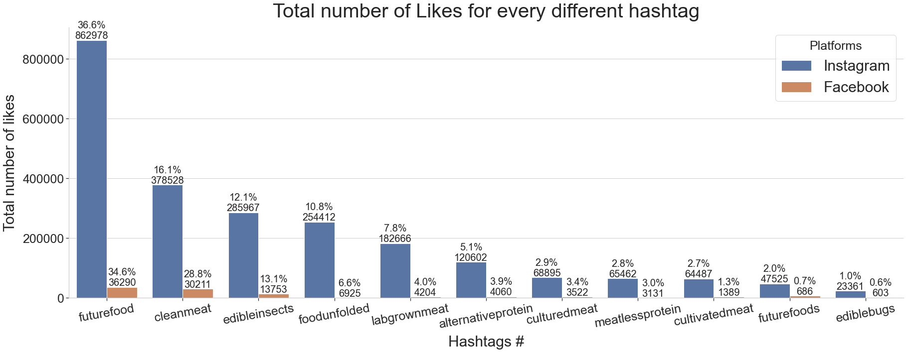
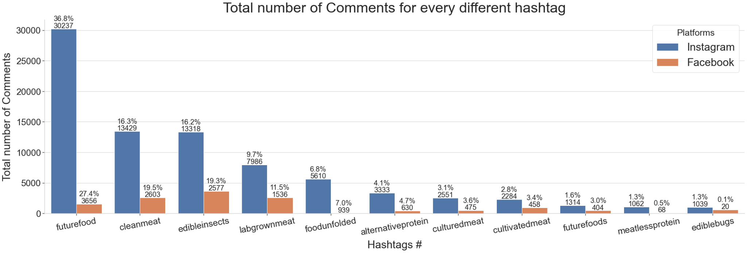
Data Visualization
Looking at Likes and Comments Individually we can see that majority of the interactions of a post comes from receiving likes and only a fraction are from commenting
#Futurefood is very popular across the two different platforms
Facebook Platform receives significantly less Likes and Comments due to the lack of popularities.

Slide 12
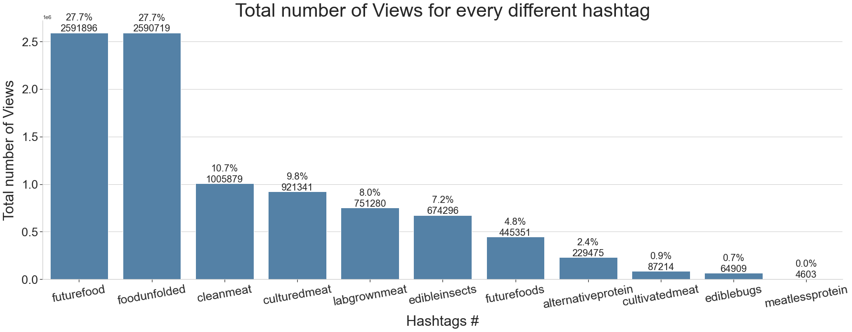
Data Visualization
Instagram Platform Only
* Views are only available for Instagram data
#Futurefood and #Foodunfolded are about the same when considered the total number of views they each receive
#Foodunfolded was ranked fourth in terms of total interactions, we should isolate this hashtag to see if itself is the true factor when attracting views

Slide 13
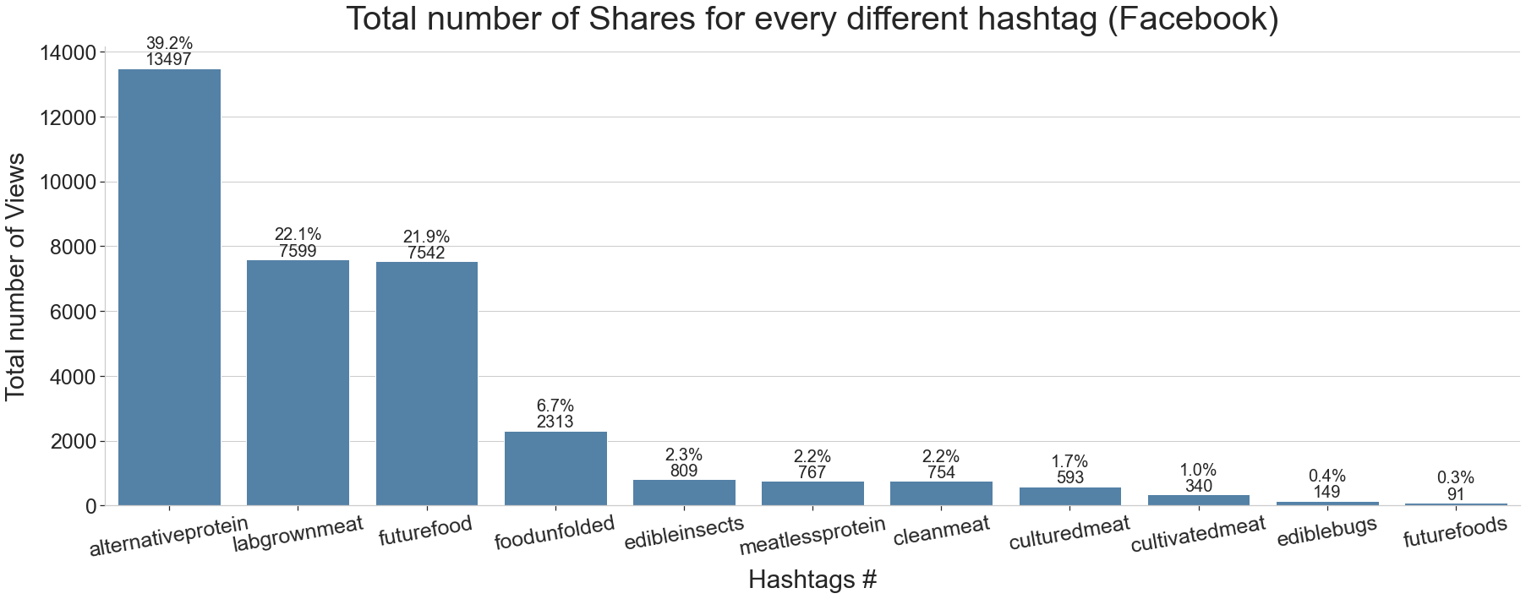
Data Visualization
Facebook Platform Only
* Shares parameter are only available for Facebook data
#alternativeprotein, #labgrownmeat, #futurefood receive more than 80% of the total share volumes.

Slide 14
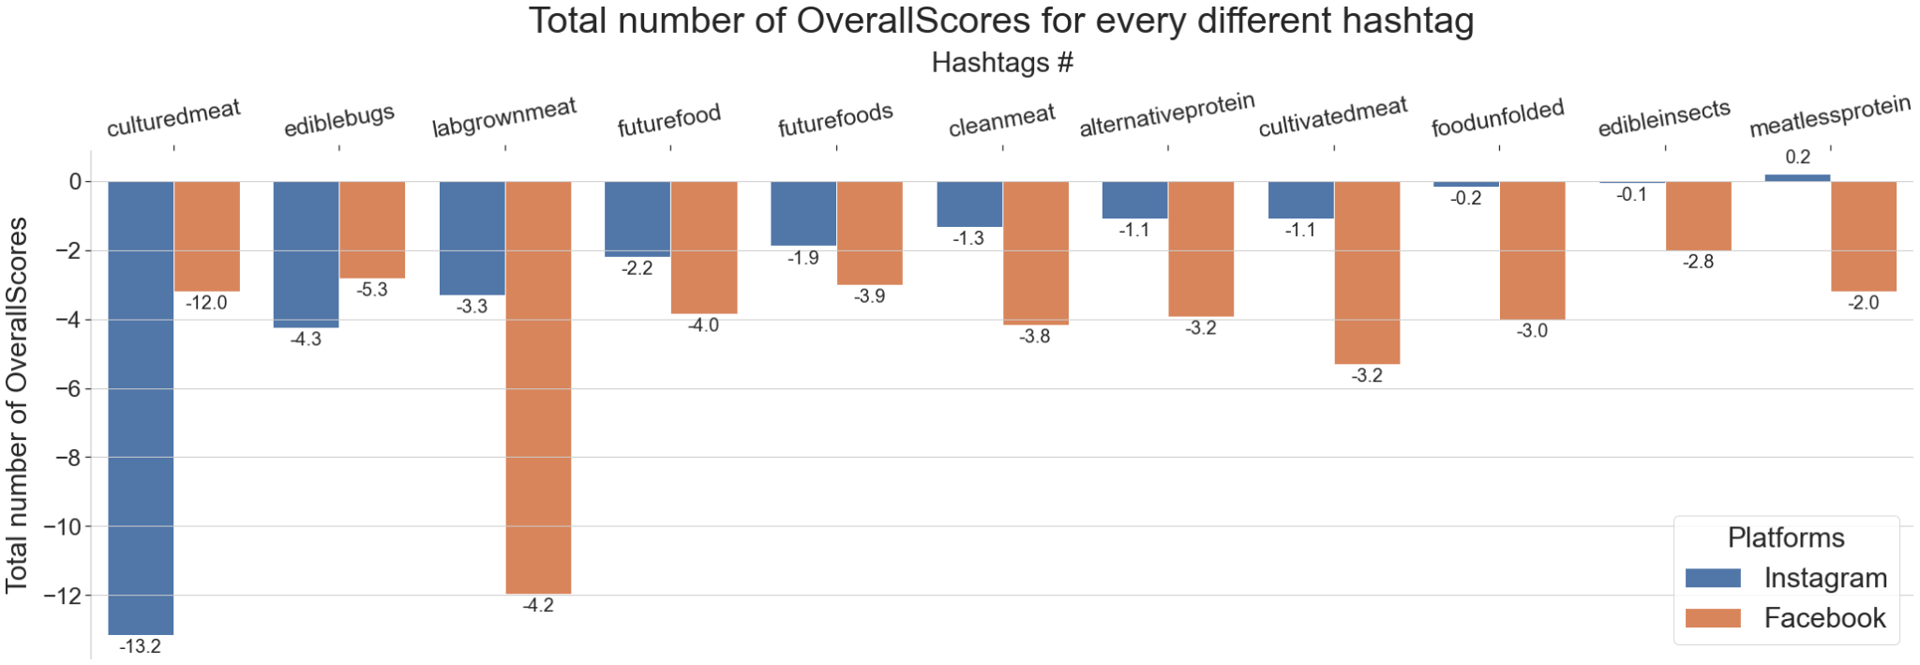
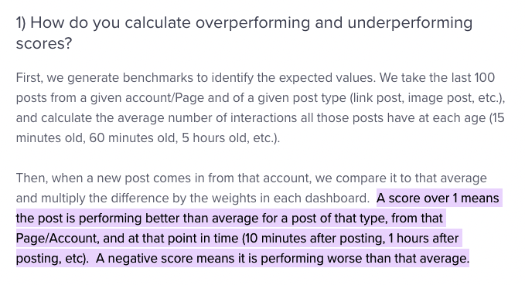
Data Visualization
Here I’m taking averages of the OverallScores to get a better representation of how each hashtag performs
Almost all of the hashtags are performing worse than average, however #meatlessprotein on Instagram Platform seems to have a positive average OverallScores (+0.2)

Slide 15
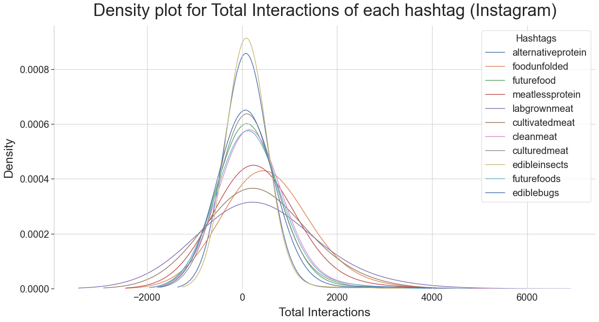
Data Visualization
Wrote a z score function to eliminate outliers outside of z of -+3

Slide 16
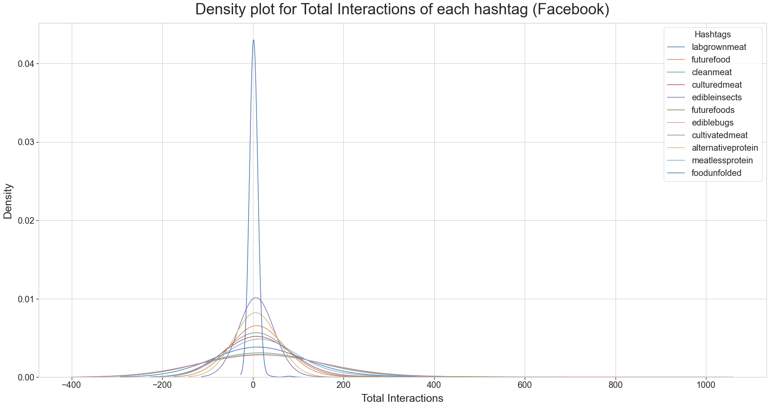
Data Visualization
Wrote a z score function to eliminate outliers outside of z of -+3

Slide 17
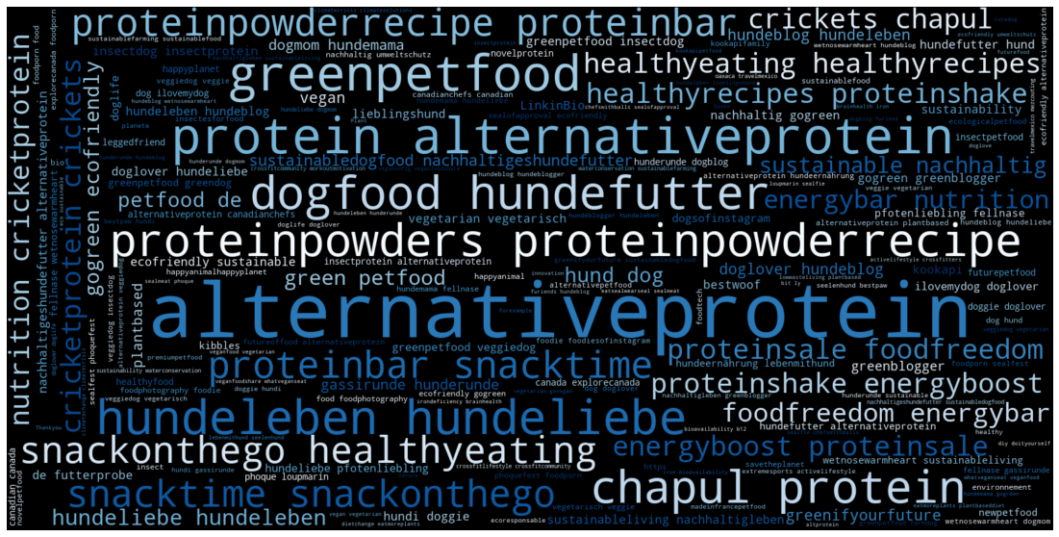
Data Visualization - Word Cloud
#Alternativeprotein

Slide 18
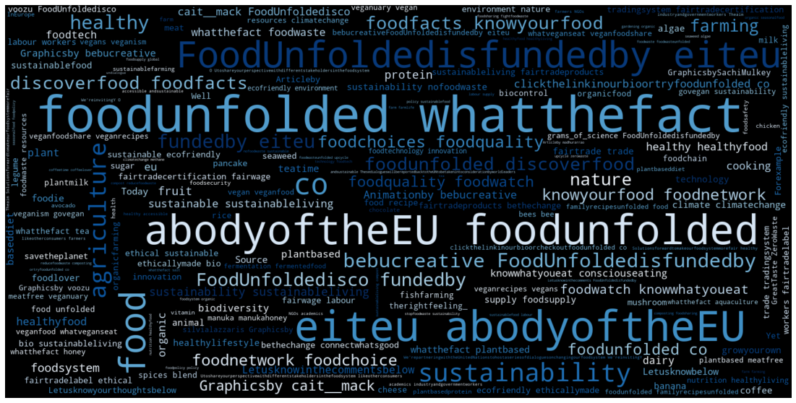
Data Visualization - Word Cloud
#Foodunfolded

Slide 19
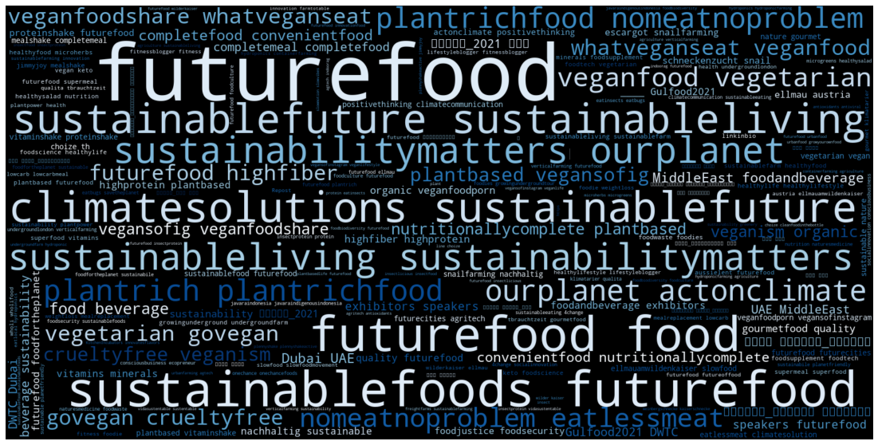
Data Visualization - Word Cloud
#Futurefood

Slide 20
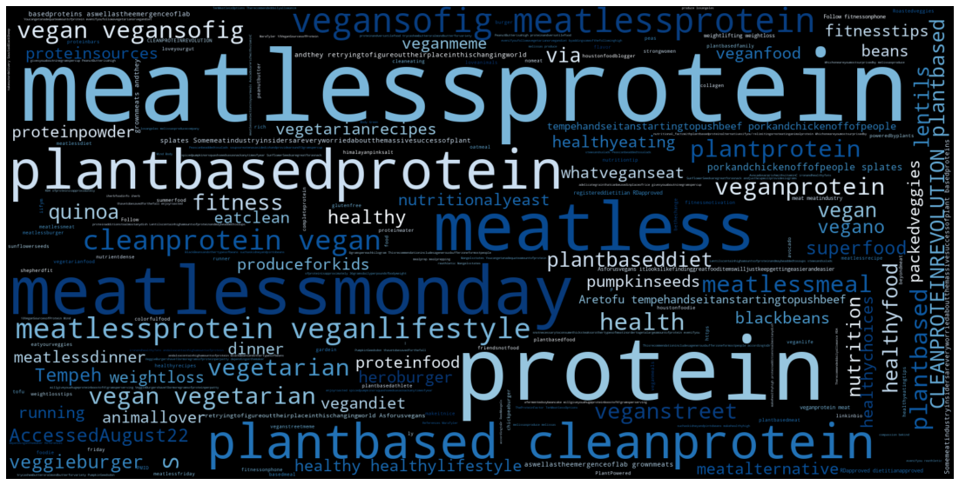
Data Visualization - Word Cloud
#Meatlessprotein

Slide 21
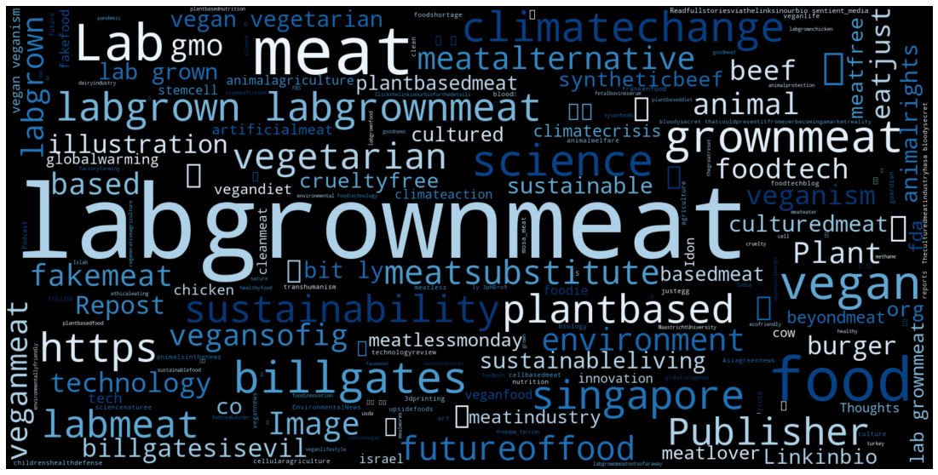
Data Visualization - Word Cloud
#Labgrownmeat

Slide 22
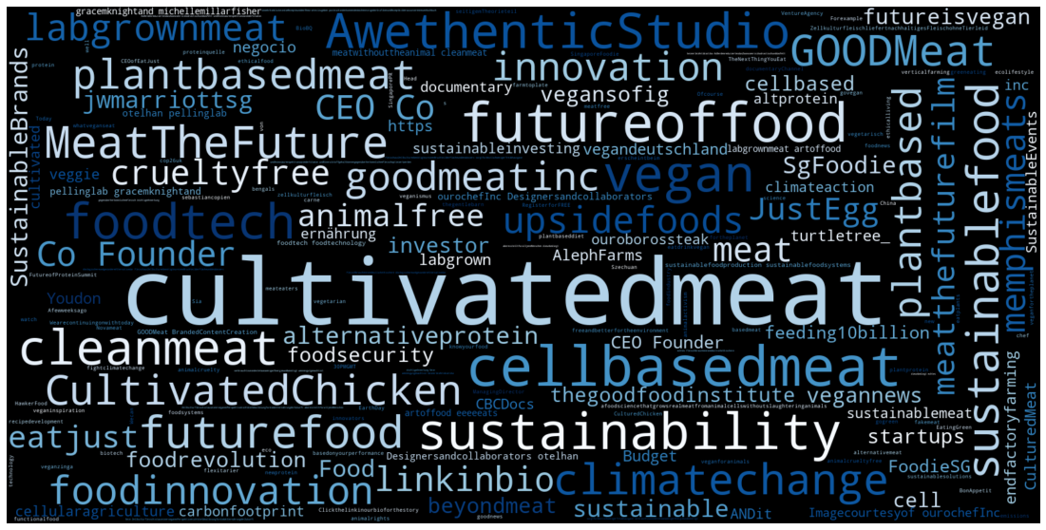
Data Visualization - Word Cloud
#Cultivatedmeat

Slide 23
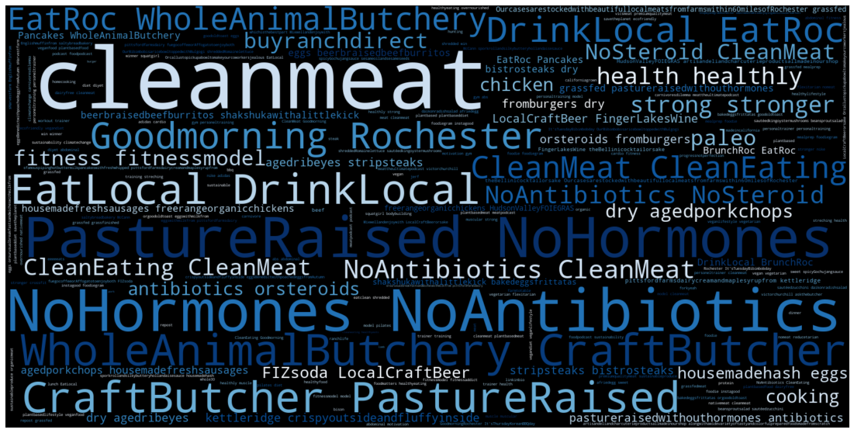
Data Visualization - Word Cloud
#cleanmeat

Slide 24
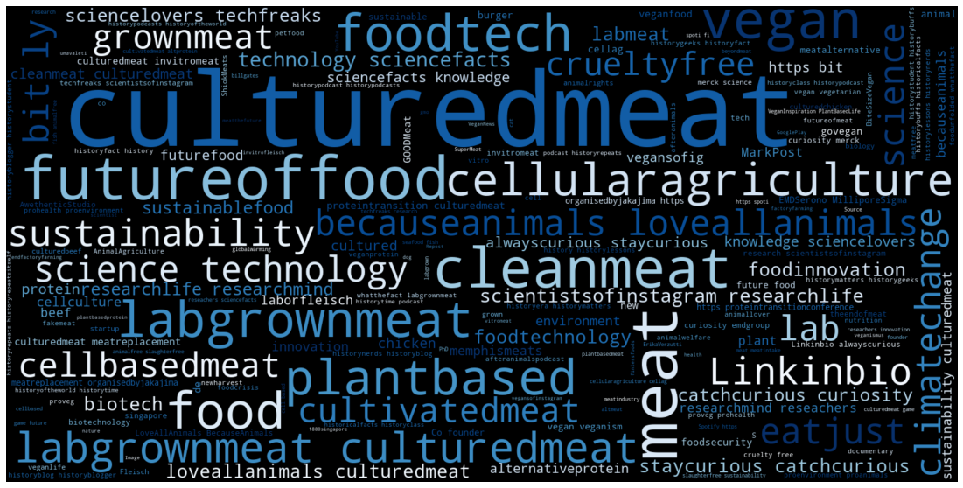
Data Visualization - Word Cloud
#culturemeat

Slide 25
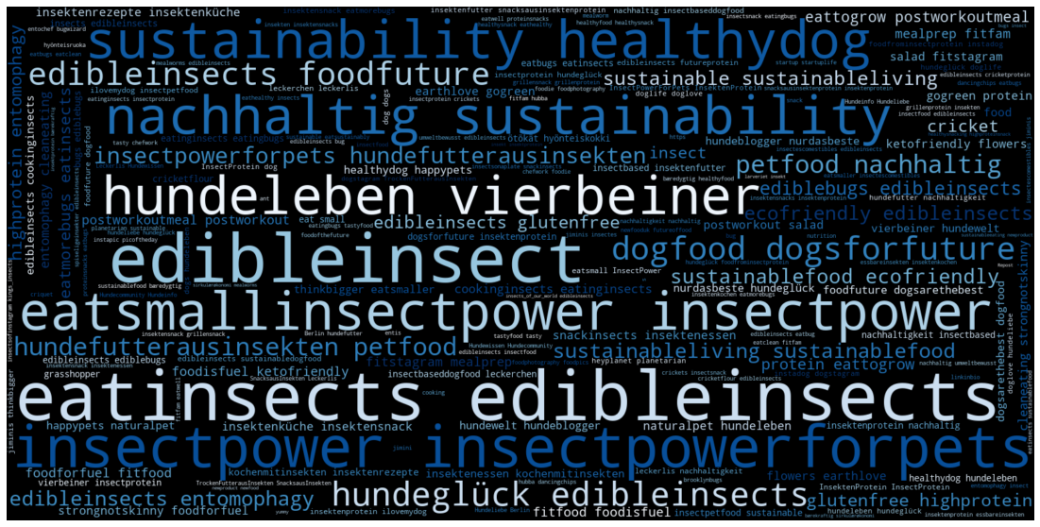
Data Visualization - Word Cloud
#edibleinsects

Slide 26
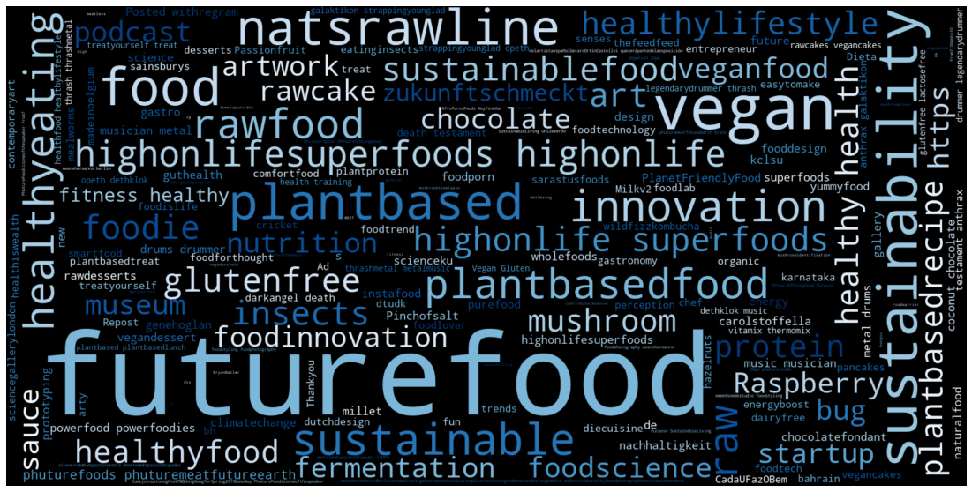
Data Visualization - Word Cloud
#futurefood

Slide 27
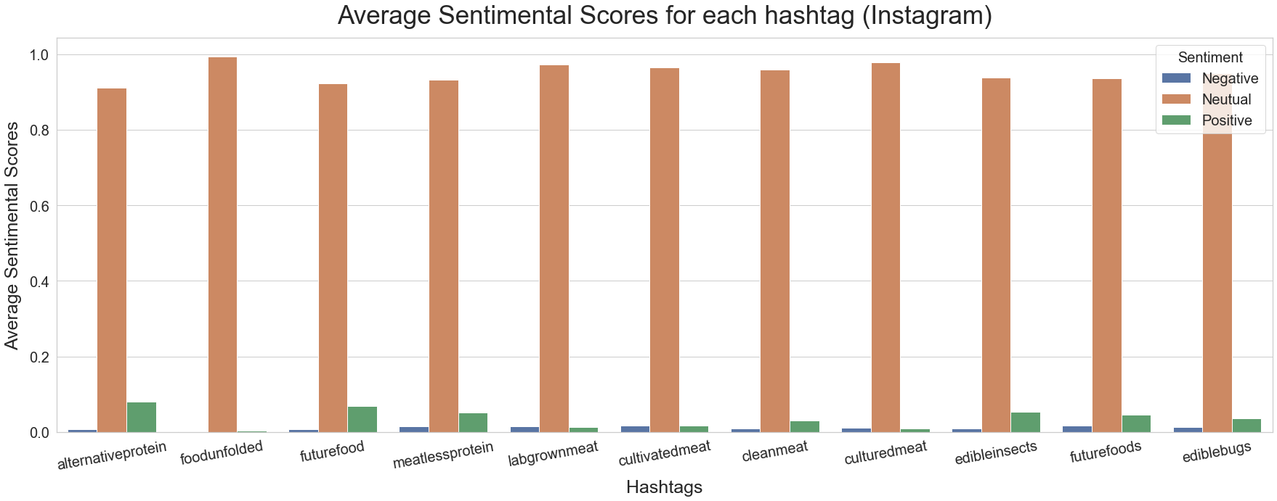
Sentimental Score Visualization (Instagram)
Using vaderSentiment Package we were able to generate sentimental scores by analyzing the description contents from the posts.
Since neutral columns for each hashtag are all close to 1, we can remove the neutral column to better visualize the Negative and Positive columns.

Slide 28
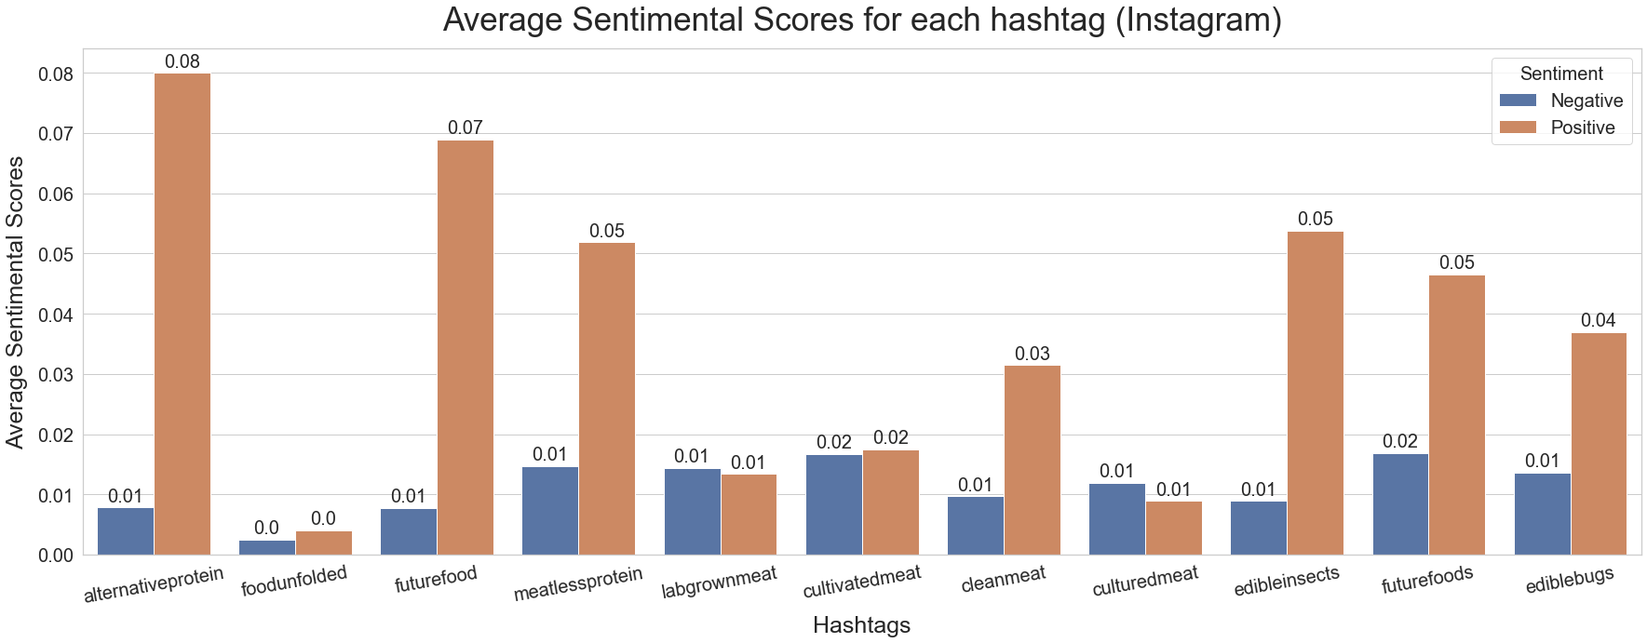
Sentimental Score Visualization (Instagram)
Using vaderSentiment Package we were able to generate sentimental scores by analyzing the description contents from the posts.
Overall the sentiment for all hashtags are all on the Positive side. Hashtags like #foodunfolded, #labgrownmeat, #cultivatedmeat, and #culturedmeat all have pretty similar positive and negative scores.

Slide 29
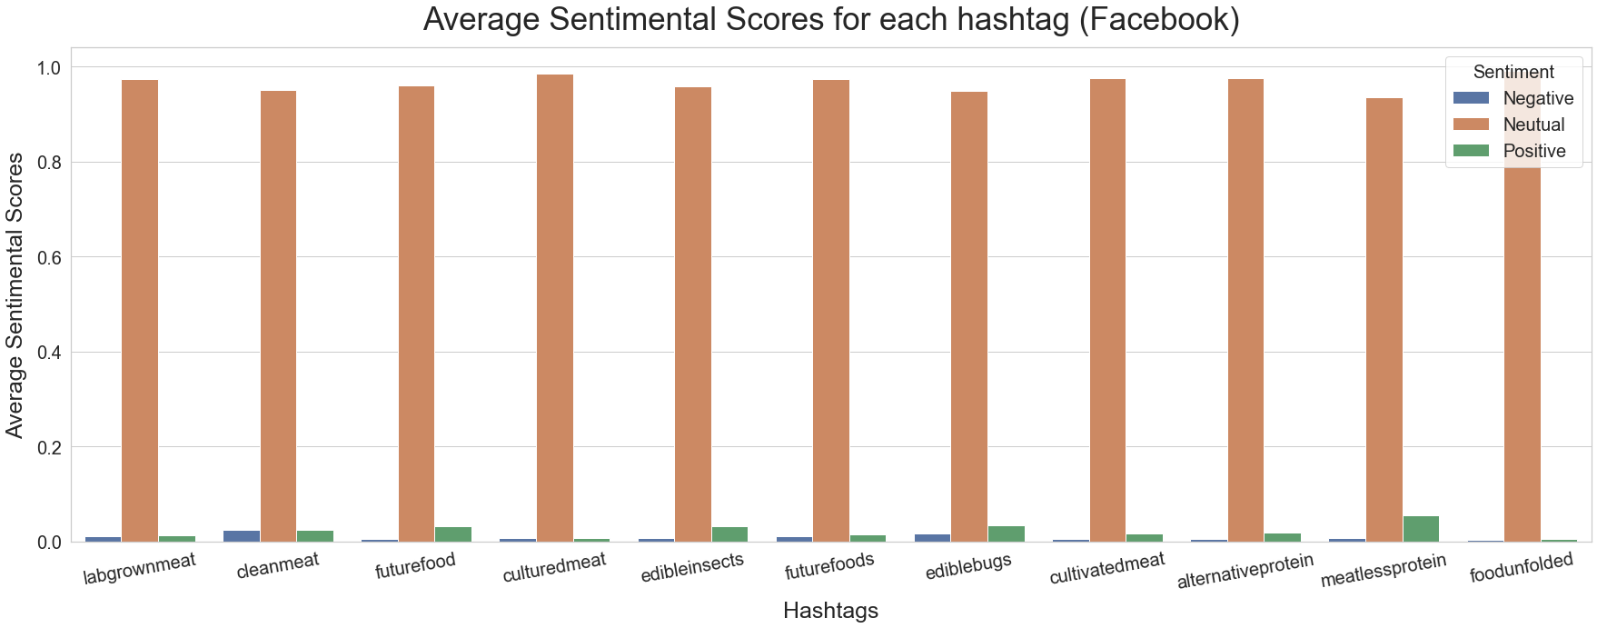
Sentimental Score Visualization (Facebook)
Using vaderSentiment Package we were able to generate sentimental scores by analyzing the description contents from the posts.
Since neutral columns for each hashtag are all close to 1, we can remove the neutral column to better visualize the Negative and Positive columns.

Slide 30
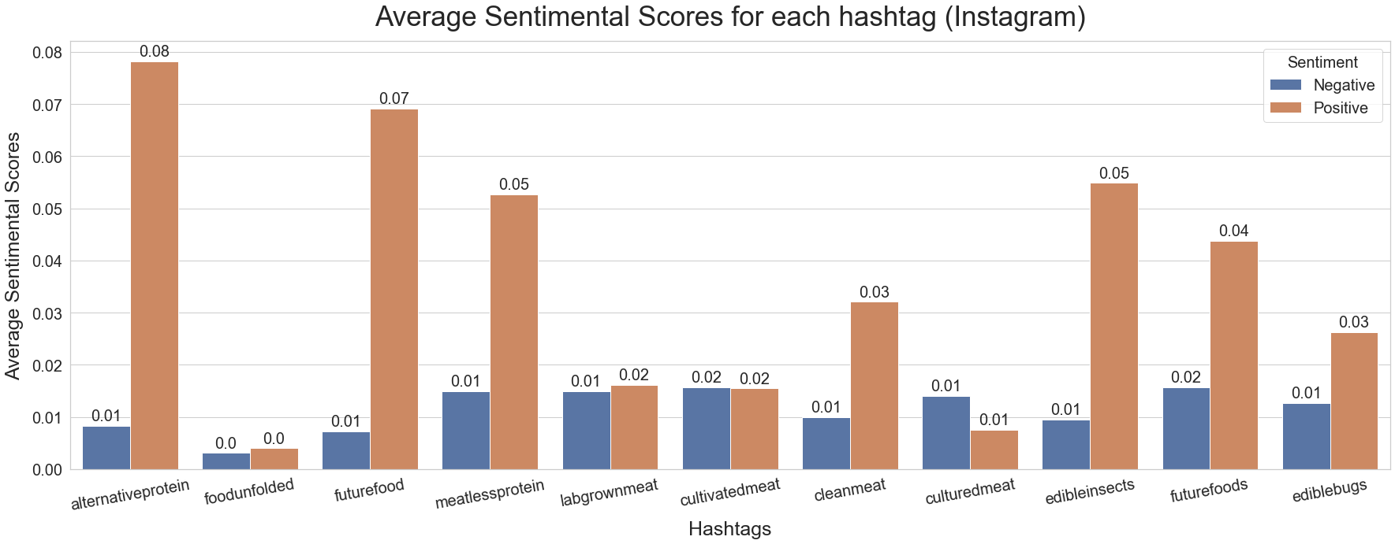
Sentimental Score Visualization (Facebook)
Using vaderSentiment Package we were able to generate sentimental scores by analyzing the description contents from the posts.
Overall the sentiment for all hashtags are all on the Positive side. #alternativeprotein has the highest positive sentimental score(0.8). Hashtags like #foodunfolded, #labgrownmeat, #cultivatedmeat, and #culturedmeat all have pretty similar positive and negative scores, keeping the same trend as the Instagram Platform.

Slide 31
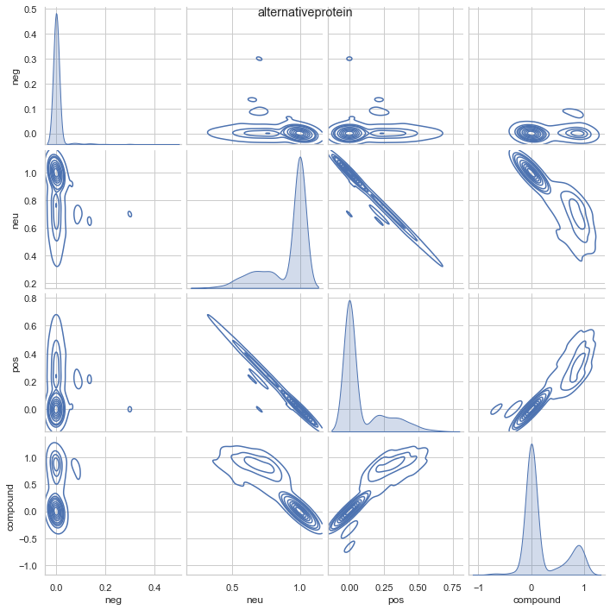
Sentimental Score Visualization

Slide 32
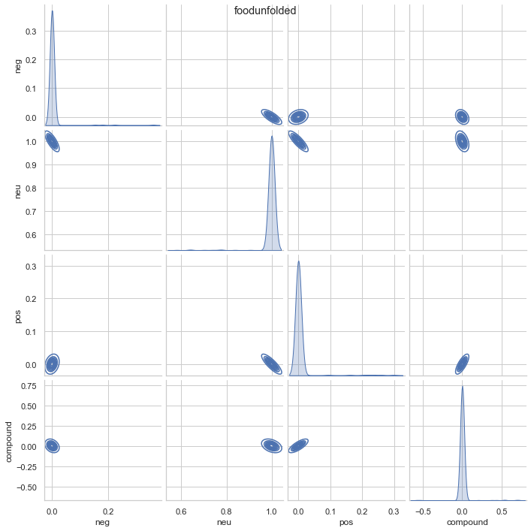
Sentimental Score Visualization

Slide 33
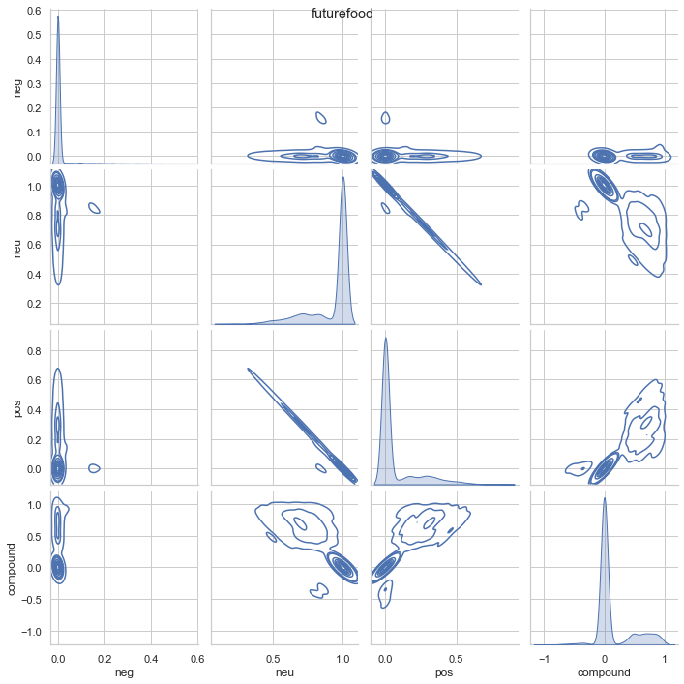
Sentimental Score Visualization

Slide 34
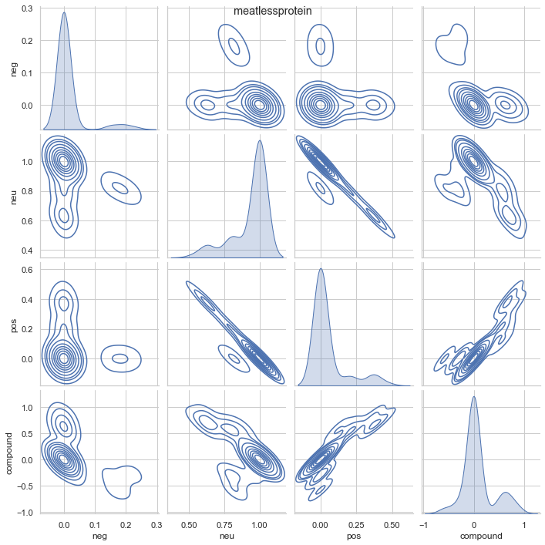
Sentimental Score Visualization

Slide 35
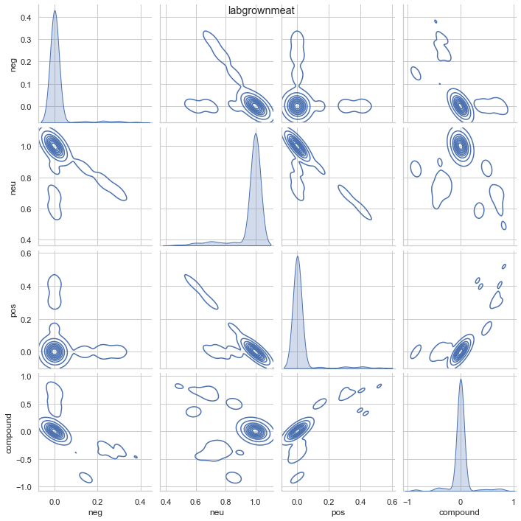
Sentimental Score Visualization

Slide 36
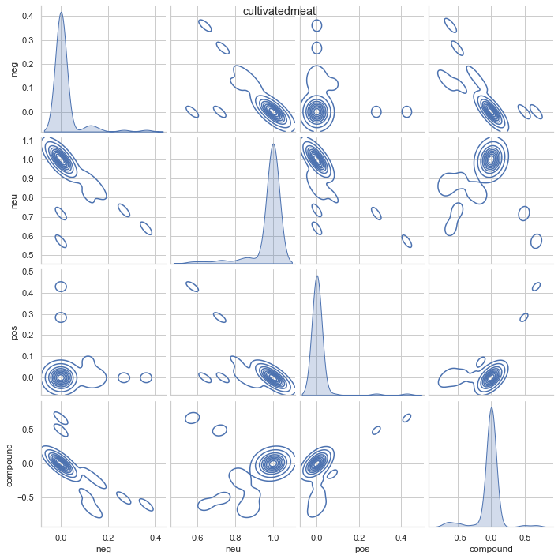
Sentimental Score Visualization

Slide 37
Sentimental Score Visualization

Slide 38
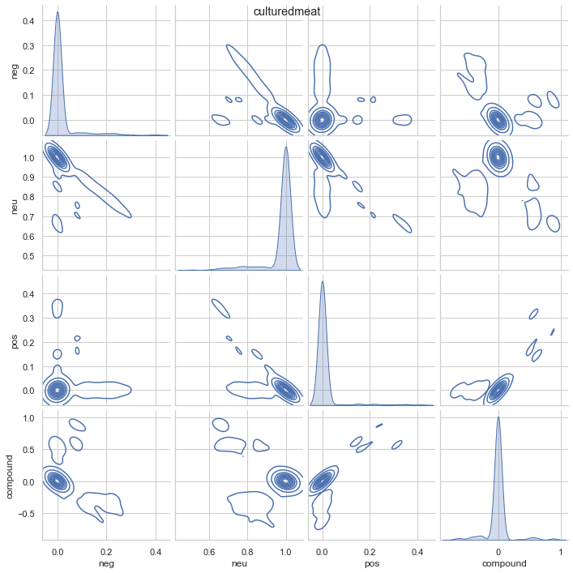
Sentimental Score Visualization

Slide 39
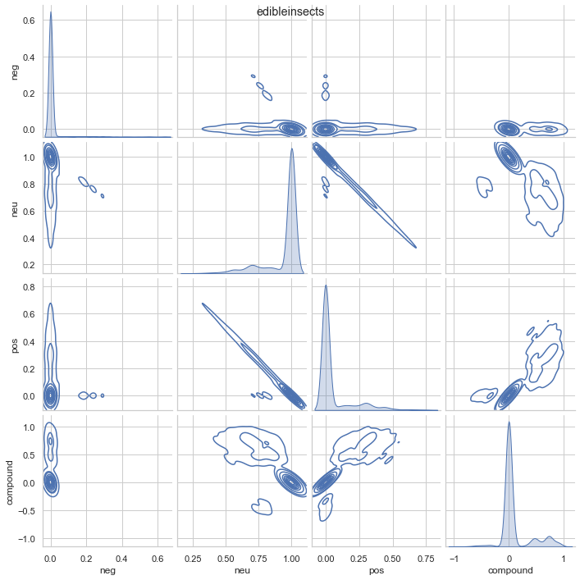
Sentimental Score Visualization

Slide 40
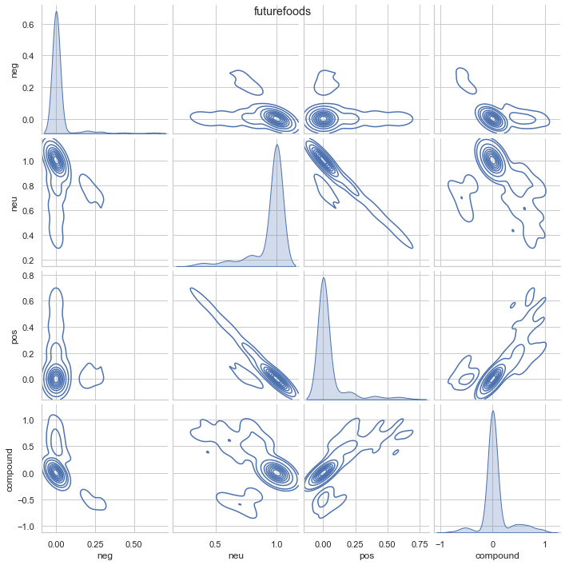
Sentimental Score Visualization

Slide 41
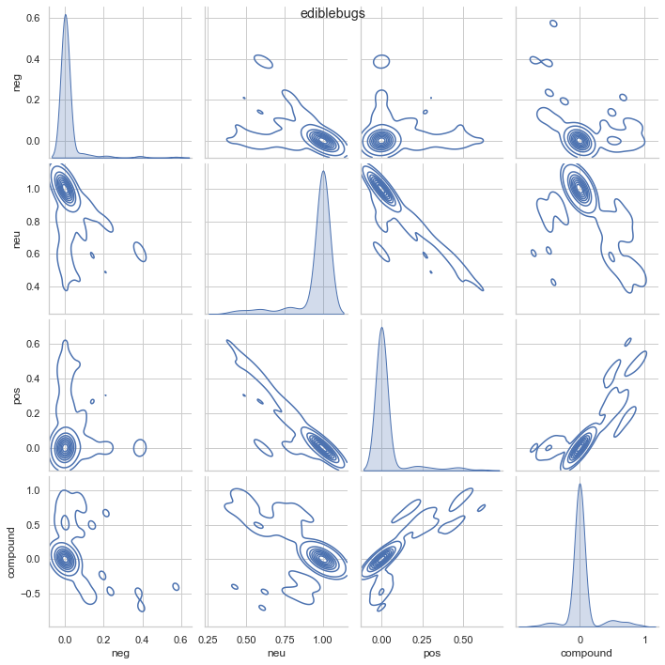
Sentimental Score Visualization

